Slide 1
[Order Management System]
[Let’s Shop e-commerce Website]
[June – July 2012]
Ashok Bijoy Debnath

Slide 2
Abstract :
“Let’s Shop” is an online e-commerce platform where anyone can buy anything. An user cannot buy an item unless he is logged in to his account.
Technologies and platforms used to achieve this –
1. ASP.NET MVC 3 (Visual Studio 2010)
2. SQL Server 2008
Enterprise Library 5

Slide 3
Features of the website

Slide 4
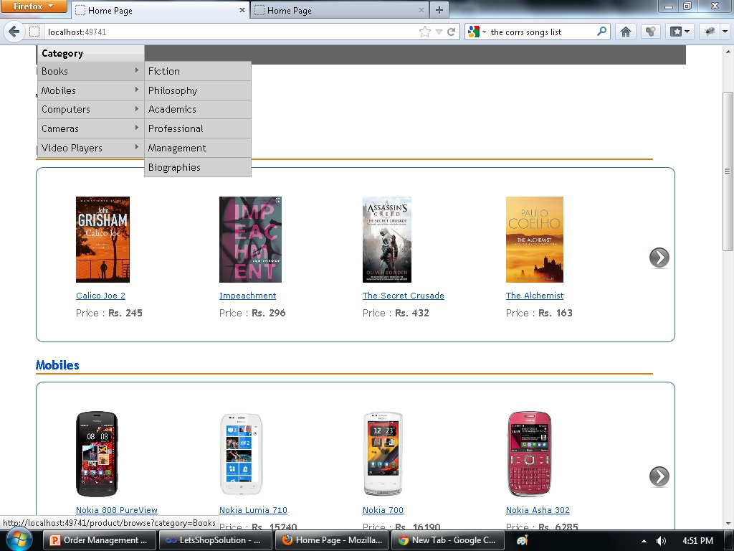
Home page

Slide 5
Register a new User
In order to buy a product, a user must first have an account.
A new user can register his account providing the minimum required fields – username, email id and password.
The username is a unique field. New users shall be prompted if the username provided is not available, and also on successful creation of his account.

Slide 6
Login functionality
In order to purchase any item, a user must login to his account.
User can login only when authentication is successful, else he shall be prompted with an error message.
Additional features (like CRUD operations on products, update order status, view all registered users and orders etc.) are available to a user if he has administrator privileges.

Slide 7
Forgot Password
If an user loses the password, he/she has the option to recover it by providing the correct answer to his/her security question.
User shall be asked to confirm his username prior to answering the security question.

Slide 8
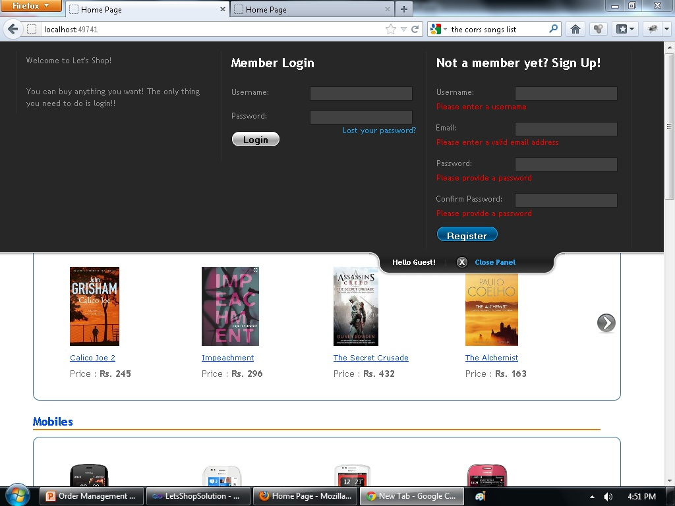
Login, Sign Up and Forgot Password sections (with jQuery validations)

Slide 9
Registered User Account
An user can store his account details any time after logging in to his account. This makes the checkout process easier.
He can update the account details if and when he needs to.

Slide 10
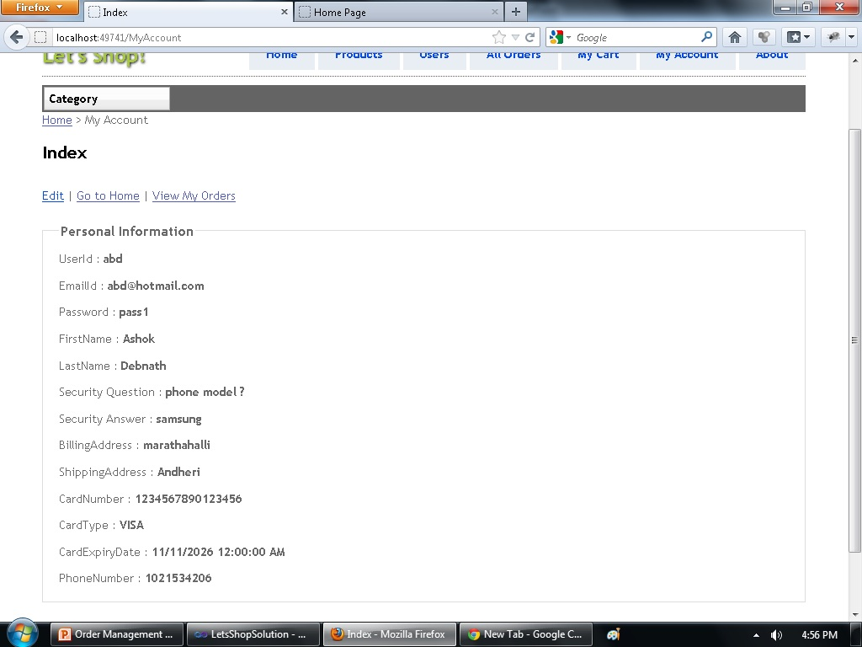
User account details

Slide 11
Administrator privileges
An administrator can do all the Create, Read, Update and Delete operations on the products in the website.
He can view the list of all the users registered with the website, and export them to an excel file.
He can change the transaction status of the order from “Processing” to “Shipped”.

Slide 12
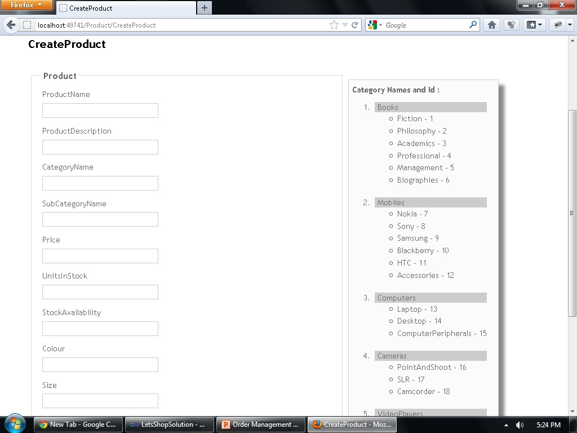
Admin creating a new product -

Slide 13
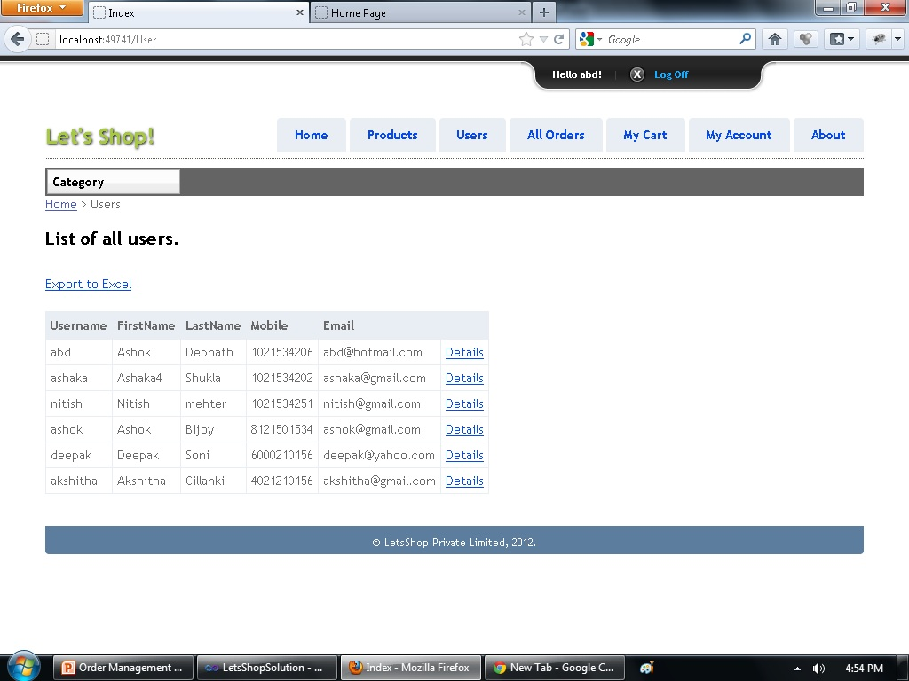
List of users – Admin page

Slide 14
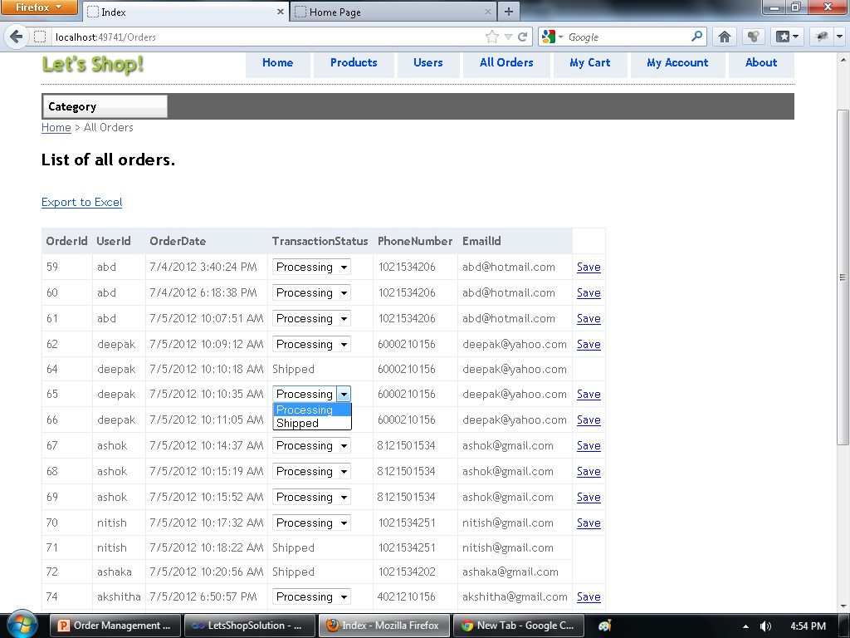
Updating transaction status – (Admin)

Slide 15
Division of Products
The products have been divided into categories and subcategories. Any user (registered or un-registered) can browse through the products in the website according to categories and subcategories.
The products have also been paged with 10 products per page. Users can jump to any page at any instant, and buy them.

Slide 16
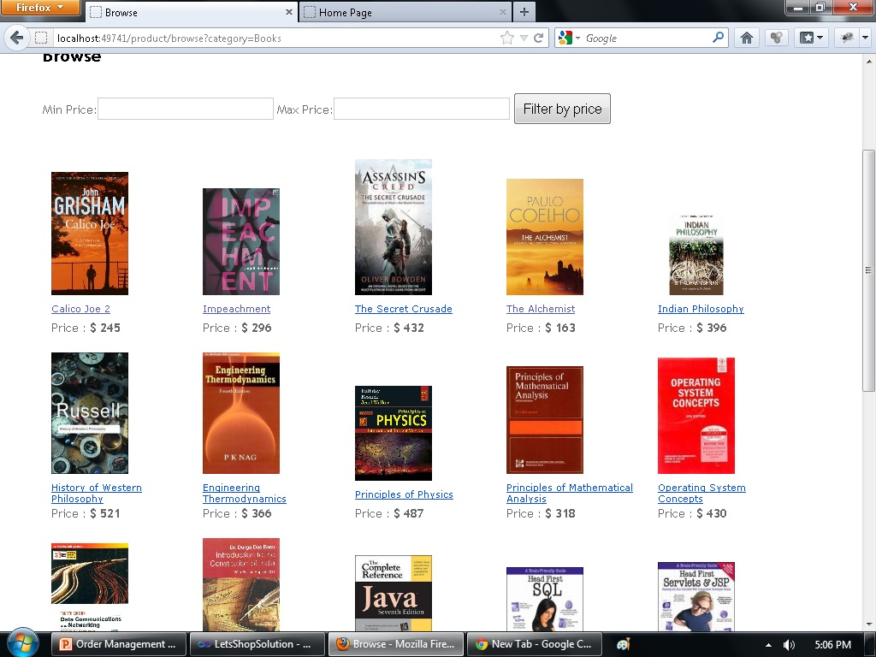
Books category page -

Slide 17
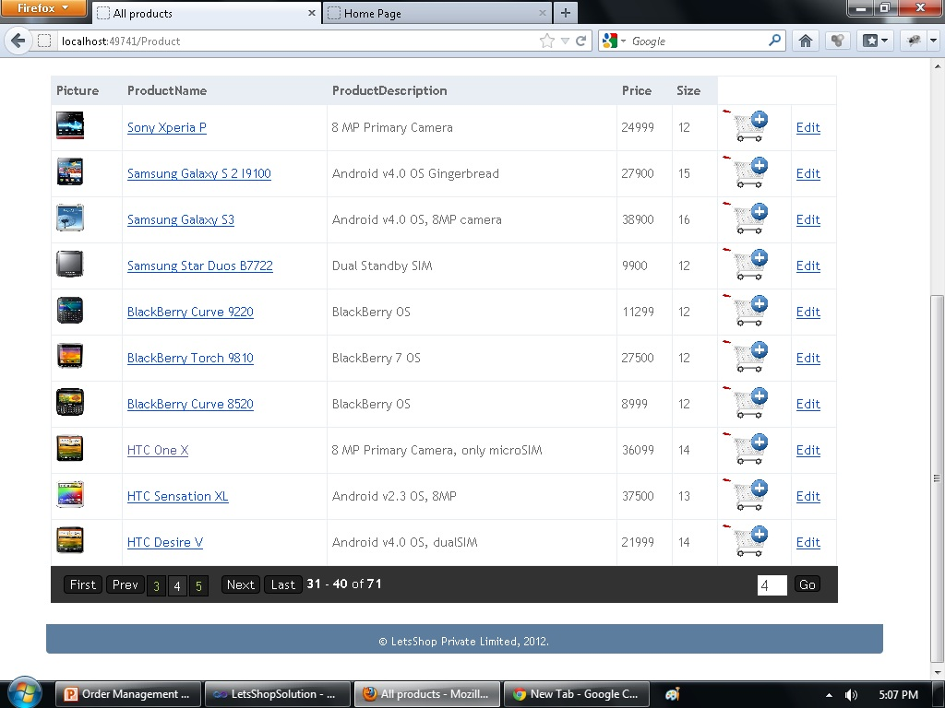
Paging of products -

Slide 18
Searching Products
Product can be searched based on their names. Any substring can be used to filter all the products that contain that string.
Multiple results are displayed, if they exist. The search results are also paged if it contains more than 10 products.

Slide 19
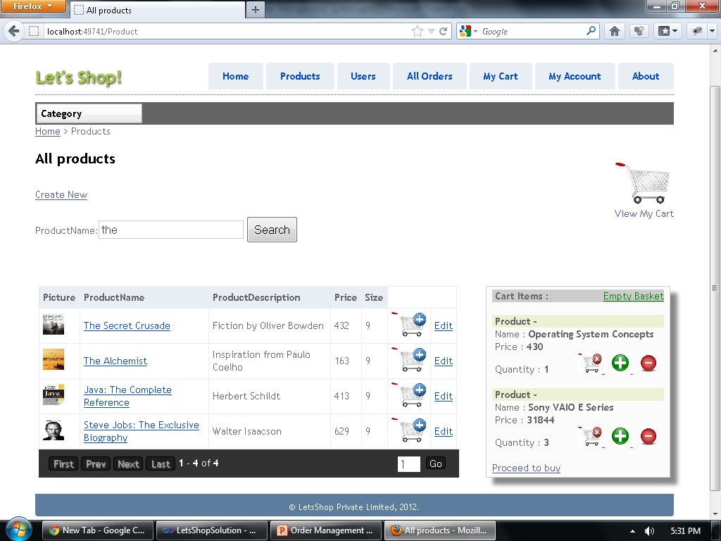
Search results for “the” -

Slide 20
Filtering products by Price
The products within a particular category can be filtered based on the minimum and maximum price provided.
The user can narrow down his search and easily place an order directly from the search results.

Slide 21
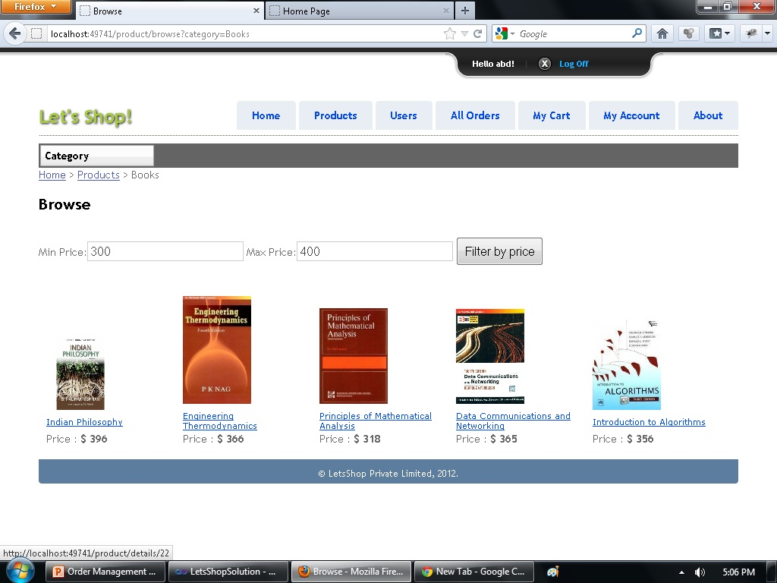
Books between Rs. 300 and 400 -

Slide 22
Cart Information
Registered users can add items to cart before proceeding to buy them.
Items stored in cart will remain even if he/she logs out, in case he/she wishes to buy them later.
Once an item is added to cart, the user can increase or decrease the quantity of the item he wishes to buy. Or, he can even remove the item altogether.
Cart will be cleared once an order is placed. User can also clear the cart at one go before placing the order.

Slide 23
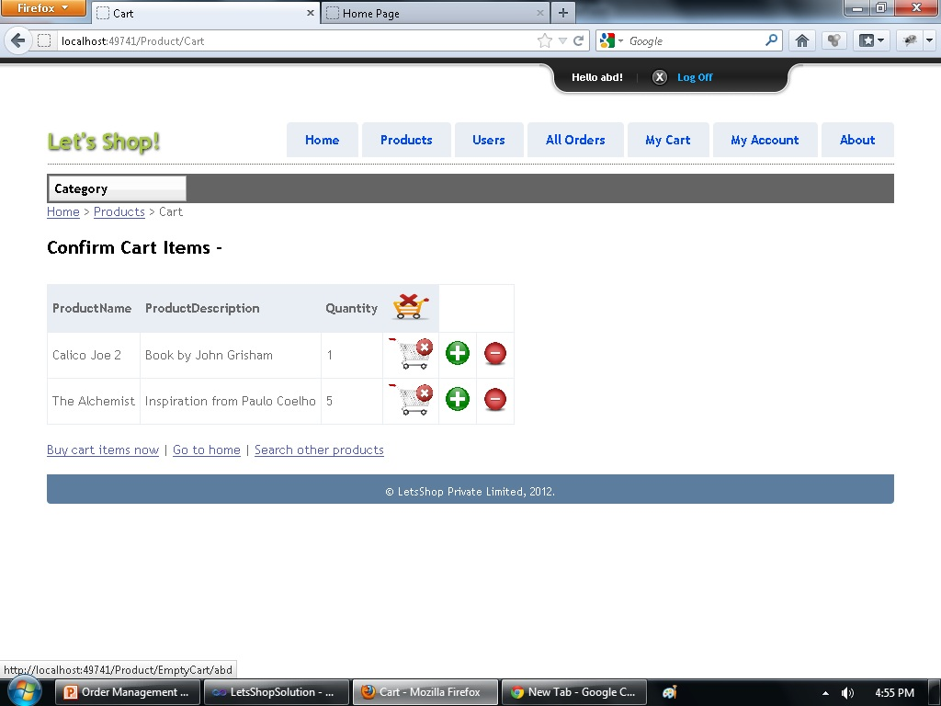
Cart page -

Slide 24
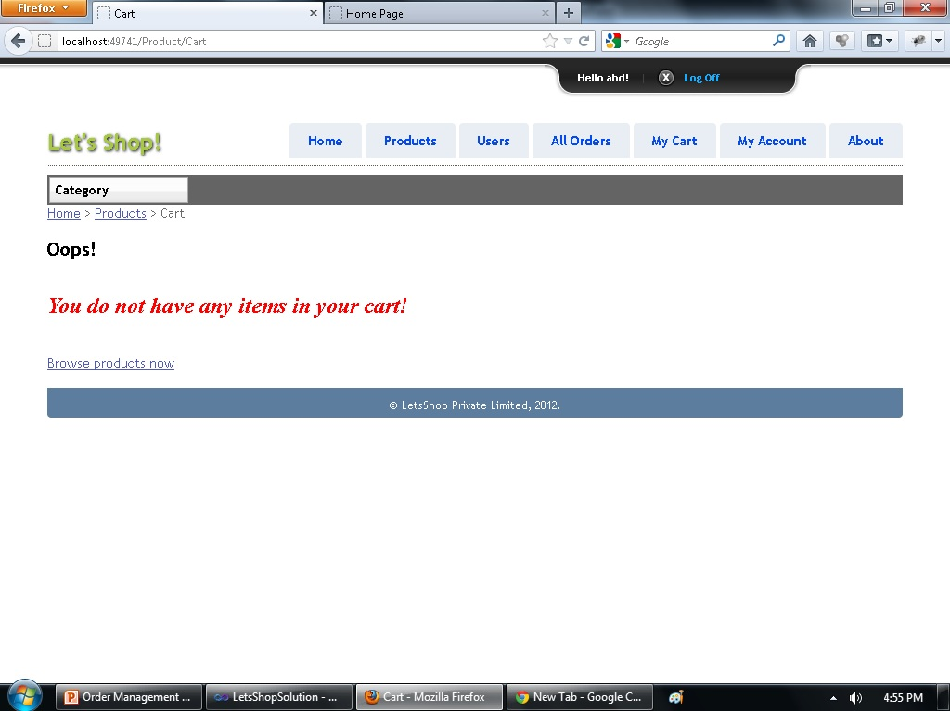
Empty Cart -

Slide 25
Checkout process
An user has to undergo the checkout process once he proceeds to buy the items in his cart.
The checkout process consists of 3 tabs – tab 1 for user details, tab 2 for order summary and tab 3 for payment details. If the user has previously filled his details, they are automatically populated in the respective fields, making the checkout process easier.
Once the checkout process is completed, the order is placed.

Slide 26
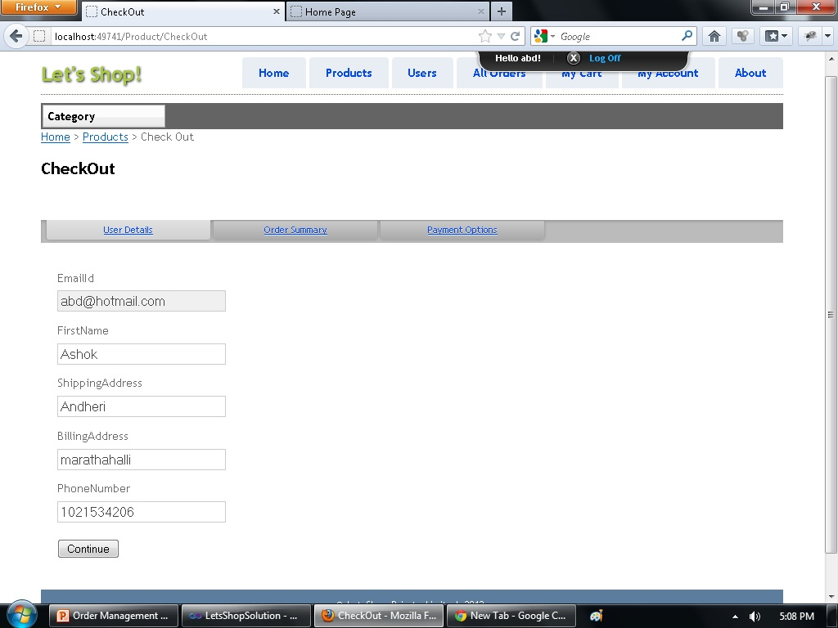
Checkout process -

Slide 27
Order tracking
Admin can track all the orders that has been placed by the registered users, and can download them to an excel file.
Any registered user can see the history of all the orders he has placed, along with its details – including the products in that order.
Users get Order statuses. When the products in an order are shipped, the user shall be updated with the information in his ‘MyAccount’ section.
He can cancel the order after it is placed, provided the order has not yet been shipped.

Slide 28
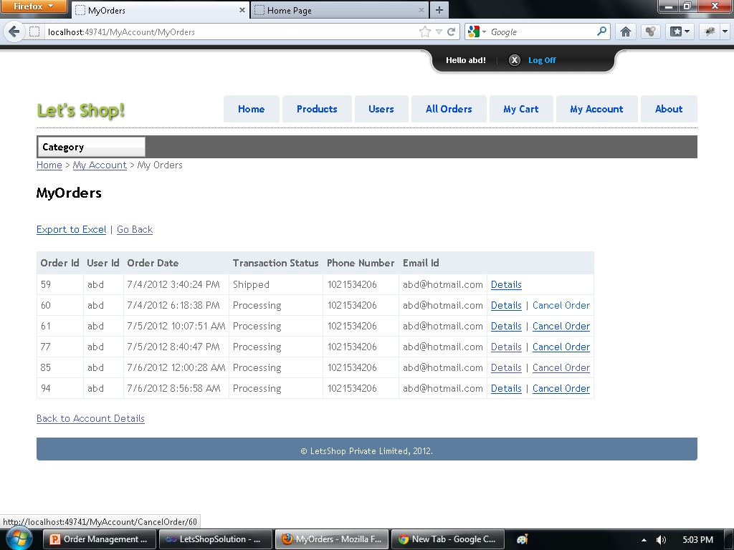
History of orders of a particular user -

Slide 29
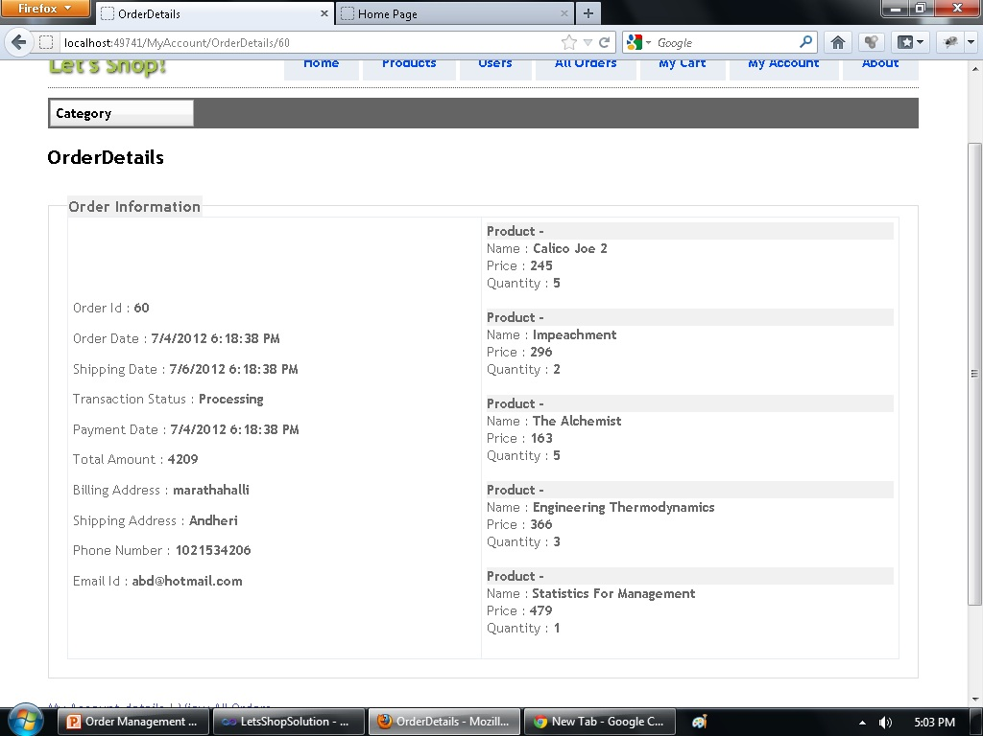
Details of a particular order -

Slide 30
Caching
Caching is done on the list of all the products in order to make the accessing faster.
The cache is given an expiration date. It exists for one day.

Slide 31
Exception logging
Exceptions encountered are logged using two policies – UI policy and Database policy.
The exceptions are caught and their details are logged in a rolling flat file, with each having a maximum capacity of 10MB.

Slide 32
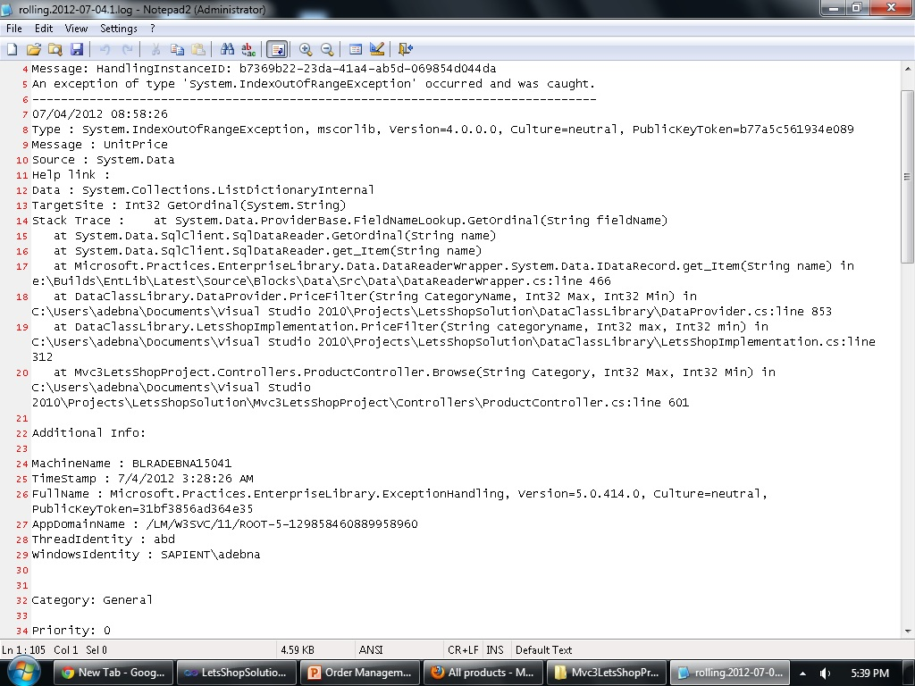
Logging the exceptions in rolling flat file

Slide 33
Mocking
Mocking is done on the Create , Update and Search functionality of products using moq.dll
Mocking of search functionality is done in two ways – search by product name and search by product id.

Slide 34
Best Practices -
Cart data –
When a product is added to cart , a green check is displayed corresponding to the product which is added.
Breadcrumb –
Navigation Path is been displayed in all the pages so that the user finds it easy to navigate in the website.
XML commenting and documentation –
Every Method is Xml-commented and a document is prepared in the bin folder which lists all the methods and their summary in the project.
Paging of products –
The list of products has been paged with 10 products per page.

Slide 35
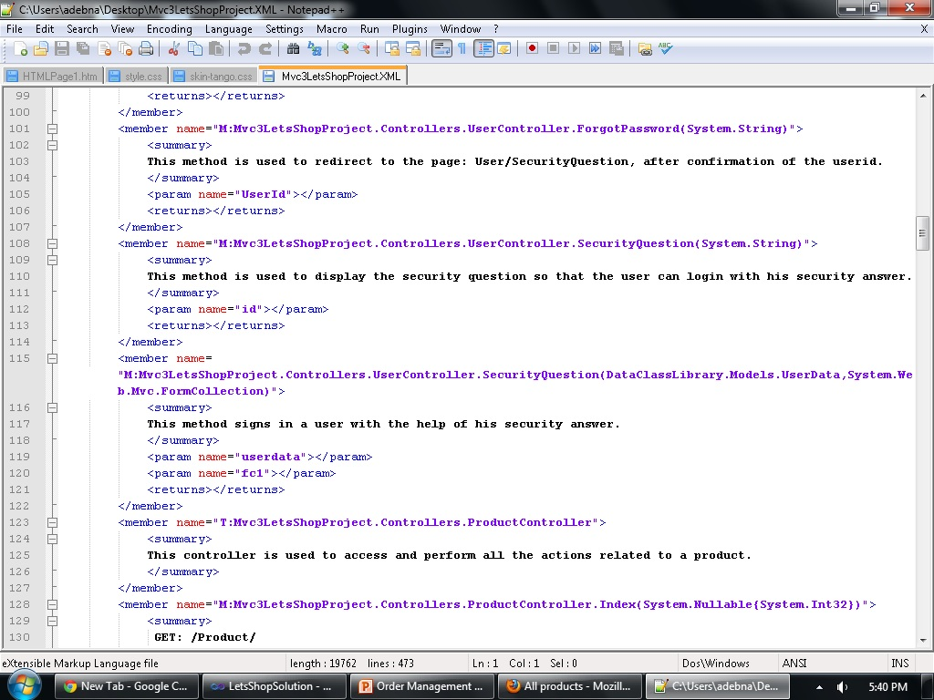
XML Documentation -

Slide 36
Layers
The models and all the class files which access the database are placed in a separate Class Library project. Controllers and Views are in one separate project.

Slide 37
Thank you !

